Slide 1

DEPARTMENT OF COMPUTER SCIENCE & ENGINEERING
SCHOOL OF COMPUTING
1156CS701- MAJOR PROJECT
INTERNSHIP THROUGH DIND/PLACEMENT/ABROAD
WINTER SEMESTER(2023-2024)
REVIEW - II
“CLIMATE STREAMERS IDENTITY PREDICTIONS”
SUPERVISED BY
Mrs.MAITHILI
Asst.Professor
PRESENTED BY
1. M RAKESH REDDY (VTU17173)(20UECS0595)
2. M V BHARGAV REDDY (VTU18173)(20UECS0630)
3. G HEMANTH (VTU17370)(20UECS0347)

Slide 2
INDUSTRY DETAILS
Industry Name : Next Click Solutions
Duration of Internship: 18 December 2023- 18 April 2024
Duration of Internship in months: 6 Months
Industry Guide Name : K. Vasanthi
Industry Guide Mobile Number : 9885488485
Industry Guide Mail ID : nextclick.vasanthi@gmail.com
Industry Address : 4th floor , Newmark house building ,Patrika Nagar, Hitech City, Hyderabad, Telangana 500082
Project Completion Status as of now : In-Progress

Slide 3
AGENDA
ABSTRACT
OBJECTIVE
INTRODUCTION
LITERATURE REVIEW (SOFT COPY OF PAPERS TO BE LINKED AS HYPERLINK)
DESIGN AND METHODOLOGIES
IMPLEMENTATION
TESTING
INPUT AND OUTPUT
INCLUDE DEMO VIDEO-1 (Till REVEW-1)
INCLUDE DEMO VIDEO-2(Complete Implementation of Project)
CONCLUSION
WEB REFERENCES LINK(TILL REVIEW DATE ALL LINKS TO BE INCLUDED DAY WISE)
INCLUDE YOUR 2 PHOTOS OF YOUR INDUSTRY WORKING ENVIRONMENT
PLAGIARISM REPORT OF PPT
REFERENCES

Slide 4
ABSTRACT
Weather and climate prediction have been crucial in human history for enabling effective agricultural planning, safeguarding against natural disasters, and facilitating strategic decision-making in various sectors. In this context, the need for accurate and timely forecasting is highly significant. Machine learning has the potential to improve the accuracy and speed of weather and climate prediction. This comprehensive survey assesses the efficacy of Machine Learning (ML) and Machine Learning-Enhanced (ML-Enhanced) methodologies in short-term weather forecasting and medium-to-long-term climate prediction. While ML shows promising results in short-term weather prediction, its role remains supplementary in medium-to-long-term climate forecasting due to the complexity of climate conditions and limited data samples. The study finds ML to be fast, scalable, and relatively accurate; however, traditional methods remain indispensable, particularly for medium-to-long-term forecasts, where understanding the mechanisms of meteorological changes is pivotal.
Keywords: machine-learning; weather prediction; climate prediction; survey

Slide 5
OBJECTIVES
Aim of the Project: Predicting the future identity of climate streamers involves considering various factors such as their current platform, audience engagement, content focus, and potential for growth. Those who effectively communicate scientific findings, engage audiences, and provide actionable solutions may gain traction in the climate streaming space. It's likely that these streamers will continue to amplify discussions around climate change, advocate for sustainability, and collaborate with experts and organizations in the field.
Scope of the Project: Predicting the identity of climate streamers can be challenging, as it depends on various factors such as their backgrounds, expertise, and motivations. However, we can anticipate that climate streamers may include scientists, activists, educators, policymakers, journalists, and individuals passionate about environmental issues. As for their scope, climate streamers may cover a wide range of topics related to climate change, including scientific research, policy analysis, environmental activism, sustainable lifestyle tips, and climate-related news and events. Their scope could vary depending on their focus and audience preferences.

Slide 6
INTRODUCTION
Machine learning is a branch of computer science concerned with automated recognition of (spatio-temporal) patterns from data (Mitchell, 1997). It has been increasingly employed in the study of “big data” with the aim to investigate data syntactically and semantically. In essence, this means an automated search for a best model, given a certain task and corresponding data. Given a task, a human learns what to do and -hopefully- optimizes the working schedule according to the given side conditions. This is how machines learn from data: a task is formulated and then a learning process starts, which consists in building statistical models (in terms of probability distributions) or functional models. Eventually, optimality criteria and discriminant functions are used to evaluate the performance of such a model given new data.The algorithms are divided roughly into three different categories: supervised learning, unsupervised learning and reinforcement learning. Machine learning has shown to be very efficient in prediction, for example in solar energy prediction for solar 30 power plants (Sharma et al., 2011). This forecasting task can be reduced to learning how the solar plant reacts to the environmental conditions, and forecasting the future response of the plant using reliable weather data. In particular the occurrence of an El Ni event has large impacts on the weather around the Pacific (Reilly, 2009). It is therefore crucial to develop precise and reliable predictions of such events with considerable lead time and, if so, provide information on how the events could develop in time..

Slide 7
LITERATURE REVIEW
[1] S. A. Changnon, “Inadvertent Weather Modification in Urban Areas: Lessons for Global Climate Change,” Bulletin of the American Meteorological Society, Vol. 73, No. 5, 1992.
This survey found a strong recognition of the models’ potential in decision making, but also limited agreement that these models actually reach that potential in practice. Collaboration between planning and modeling communities is deemed essential for transitioning models into practice. Data availability is considered a stronger restraining factor by respondents with limited algorithmic experience, which may indicate that model input data are becoming more specialized, thus significantly limiting wide-spread applicability.

Slide 8
LITERATURE REVIEW
[2] Langford, I. H., & Bentham, G. (1995). The Potential Effects of Climate Change on Winter Mortality in England and Wales. International Journal of Biometeorology, 38, 141-147.
This paper gives a brief introductory review of the literature on the links between cold conditions and health, and statistical models are subsequently developed of the associations between temperature and monthly mortality rates for the years 1968 to 1988 for England and Wales. Other factors, particularly the occurrence of influenza epidemics, are also taken into account. Highly significant negative associations were found between temperature and death rates from all causes and from chronic bronchitis, pneumonia, ischaemic heart disease and cerebrovascular disease.

Slide 9
LITERATURE REVIEW
[3] Rens Kortmann (CE Delft), Edgar Peijnenborgh (RPS), Judith Harrewijn, Lindske van Hulst (SME Advies) (2007). Climate Change: Causes, Consequences, and Solutions, Scientific Background to the On-Line
This overview deals with the concept of Global Climate Change, the associated terms, causes, consequences, solutions and its potential health impact. It shows the need to act urgently if we are to avoid an irreversible build-up of greenhouse gases (GHGs) and global warming at a potentially huge cost to the economy and society worldwide. Therefore, addressing climate change requires an “unprecedented level of cooperation, not only between countries, but also between different levels of Governments, private sector and individuals.

Slide 10
DESIGN AND METHOLOGIES
MODULE 1:Data Collection and preprocessing
MODULE 2:Training and feature extraction
MODULE 3:Model Selection

Slide 11
MODULE:1
Data Collection and training using Machine Learning Algorithms
Step:1 Collection of data
Gather relevant and sufficient data for training and testing.Ensure data quality, addressing issues like missing values and outliers. Analyze and visualize the dataset to gain insights.Understand the distribution of features and relationships within the data.
Step:2 Data Preprocessing
Clean and preprocess the data for model training.Handle missing values, encode categorical variables, and scale numerical features.

Slide 12
MODULE-2
Training and Feature Extraction
Step:1 Data training and validation
Split the data into training and validation sets.Train the selected model(s) using the training data. Assess model performance on the validation set using appropriate metrics.Fine-tune hyperparameters to optimize model performance.
Step:2 Feature Extraction
Create new features or transform existing ones to enhance model performance.Consider feature selection techniques to prioritize relevant information.

Slide 13
MODULE-3
Model Selection
This project uses the Logistic regression, decision tree model and random forest model in supervised learning to predict a specific quality modification and improvement.
Logistic Regression: Effective for binary classification tasks. It focuses on simply identifying tasters who consistently rate significantly above or below average.
Random Forest: The random forest algorithm is an integration and improvement based on the decision tree algorithm and is the result of the integrated learning of the decision tree algorithm.
Decision Tree: Easy to visualize and interpret, providing insights into which features are most important for achieving desired outcomes. It creates a tree-like structure where each branch represents a decision based on a specific feature.
LSTM:LSTMs are ideal for sequence prediction tasks because they excel at capturing long-term dependencies.

Slide 14
IMPLEMENTATION
Implementing a Python with Machine Learning project involves coding the various components of the project pipeline.
Implement preprocessing steps such as handling missing values, encoding categorical variables, and scaling features.Use libraries like scikit-learn for preprocessing.
Write code to create or transform features based on domain knowledge.Implement techniques like one-hot encoding, binning, or creating interaction terms.
Write code to integrate the deployed model into the application or system.Develop unit tests, integration tests, and system tests.
Implement code for monitoring model performance, drift detection, and logging.Develop scripts for periodic model retraining or updating.

Slide 15
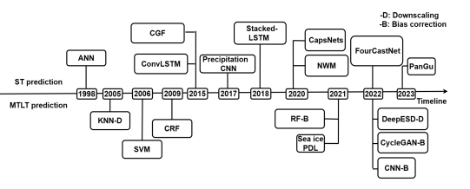
ARCHITECTURE DIAGRAM

Slide 16
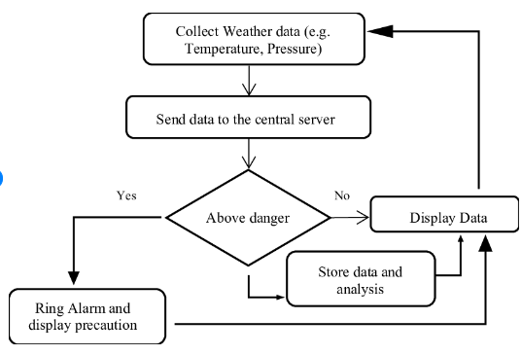
DATA FLOW DIAGRAM

Slide 17
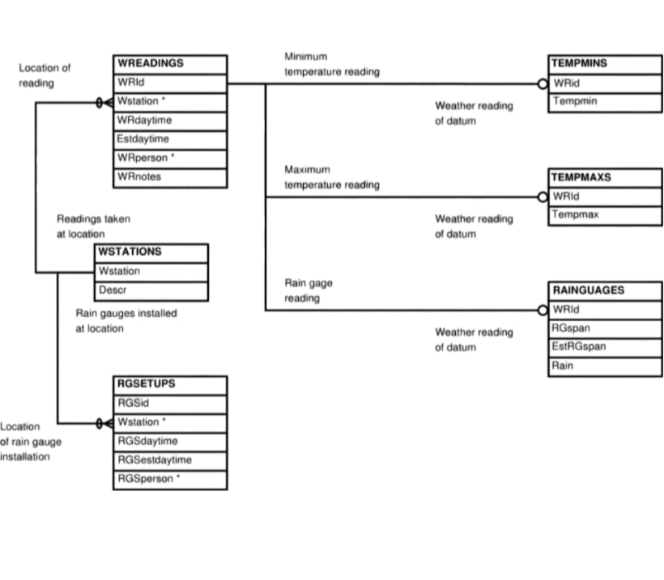
ER- DIAGRAM

Slide 18
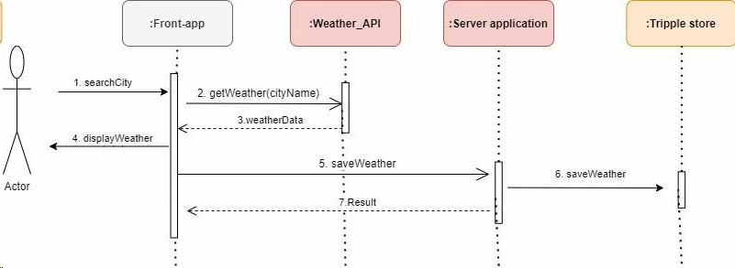
SEQUENCE DIAGRAM

Slide 19
TESTING
UNIT TESTING
INTEGRATION TESTING
FUNCTIONAL TESTING
WHITE BOX TESTING
BLACK BOX TESTING

Slide 20
UNIT TESTING
Unit testing is a method of software testing where individual units or components of a software system are tested in isolation.
Unit tests are typically written and maintained by developers as they write the code, and they help catch bugs early in the development process.
Unit testing is an essential practice in software development as it helps ensure code quality, maintainability, and reduces the risk of regressions
The goal of unit testing is to validate that each unit of code is working as intended. It involves creating test cases for individual functions, methods, or modules executing them to ensure they return the expected outputs for a given set of inputs.

Slide 21
INTEGRATION TESTING
Integration testing is a type of software testing where individual units or components are combined and tested as a group.
The goal of integration testing is to verify that the integrated components work together as expected, and that their interfaces are properly defined and implemented.
It involves testing the interactions between different modules, classes, or subsystems to ensure that they can seamlessly exchange data and collaborate to perform the desired functionality.
Integration testing is typically carried out after successful unit testing and helps identify defects related to component interactions, data sharing, and communication issues.

Slide 22
FUNCTIONAL TESTING
Functional testing is a type of software testing that verifies the software system's functionality against the specified requirements or specifications.
The goal of functional testing is to ensure that the application or system performs its intended functions correctly and meets the business requirements.
It involves testing the system's features, user interactions, input/output validation, error handling, and overall behavior from an end-user perspective.
Functional testing is typically performed using test cases that simulate real-world scenarios and user interactions with the system.
It helps identify any gaps or deviations from the expected behavior and ensures that the software meets the customer's expectations.

Slide 23
WHITE BOX TESTING
White box testing, also known as structural testing or glass box testing, is a software testing technique that involves examining the internal structure, design, and implementation details of the software under test.
The goal of white box testing is to validate the internal logic, data structures, code paths, and conditions within the code.
It involves testing the code from the inside, with complete knowledge of the source code and internal workings of the system.
White box testing techniques include control flow testing (e.g., statement coverage, branch coverage, path coverage), data flow testing, and code inspections.
This type of testing is typically performed by developers or testers with access to the source code and a deep understanding of the system's internal workings

Slide 24
BLACK BOX TESTING
Black box testing, also known as functional testing or behavioral testing, is a software testing technique that focuses on testing the software's functionality without knowing the internal implementation details or source code.
The goal of black box testing is to validate the system's behavior and outputs based on the specified requirements or specifications.
It involves testing the system from an external or end-user perspective, treating the software as a "black box" where only the inputs and expected outputs are known.
Black box testing techniques include equivalence partitioning, boundary value analysis, decision table testing, and use case testing.
This type of testing is typically performed by testers who do not have access to the source code and rely solely on the software's specifications, requirements, and user interfaces.

Slide 25
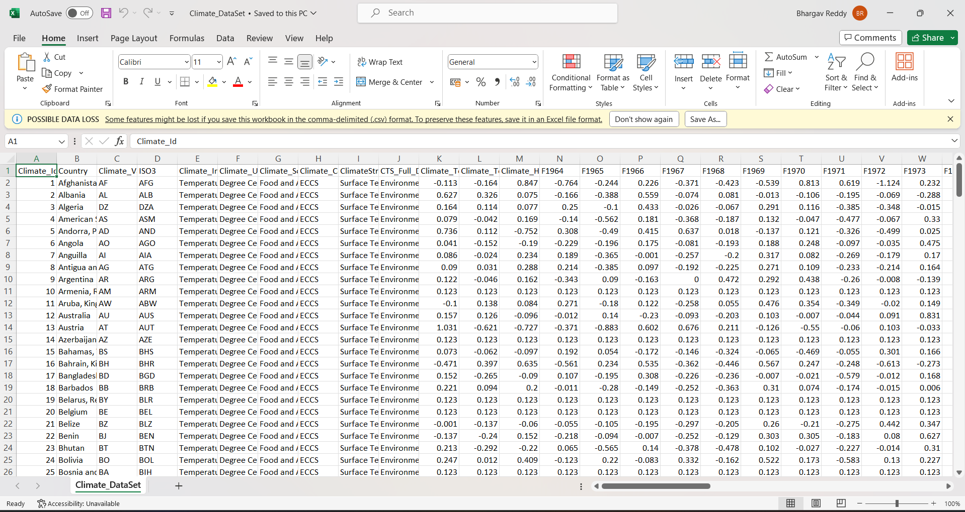
INPUT AND OUTPUT

Slide 26
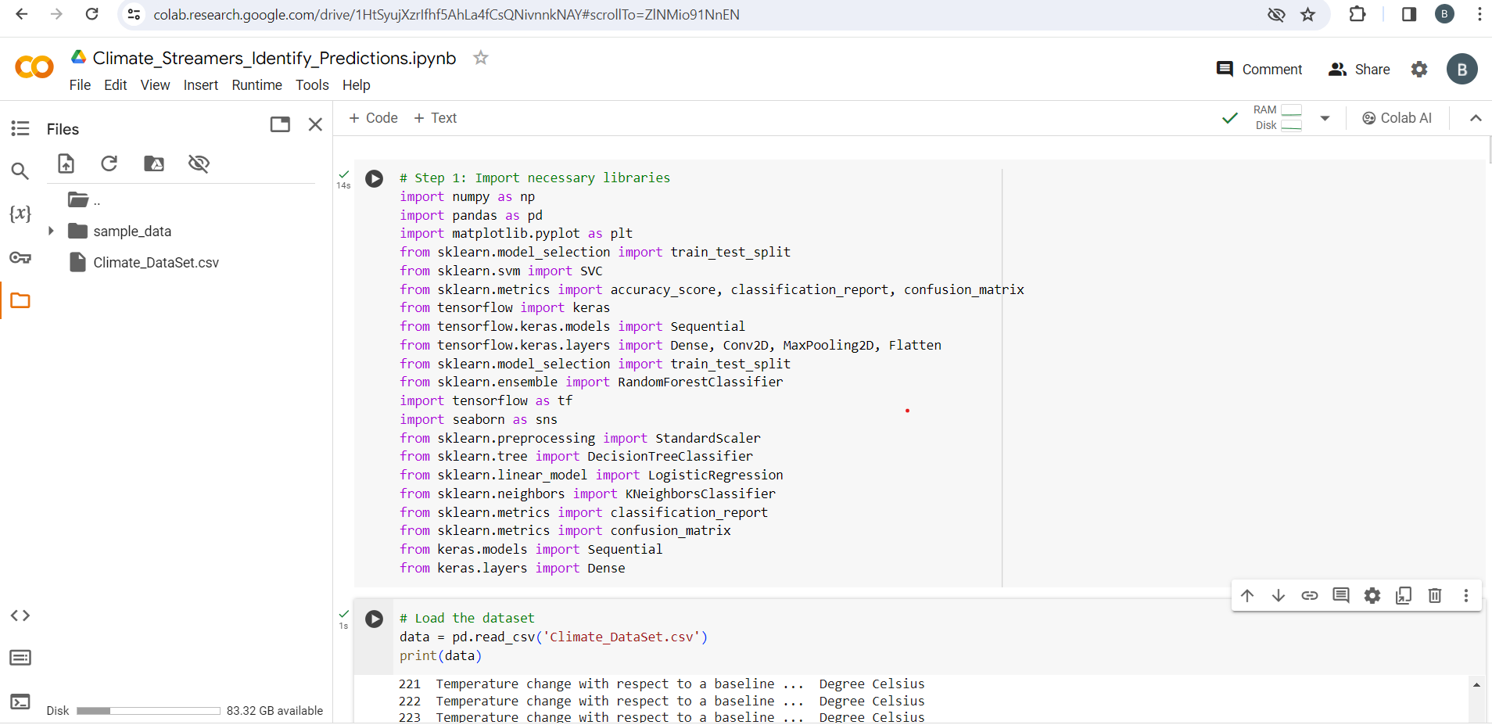
Input AND OUTPUT

Slide 27
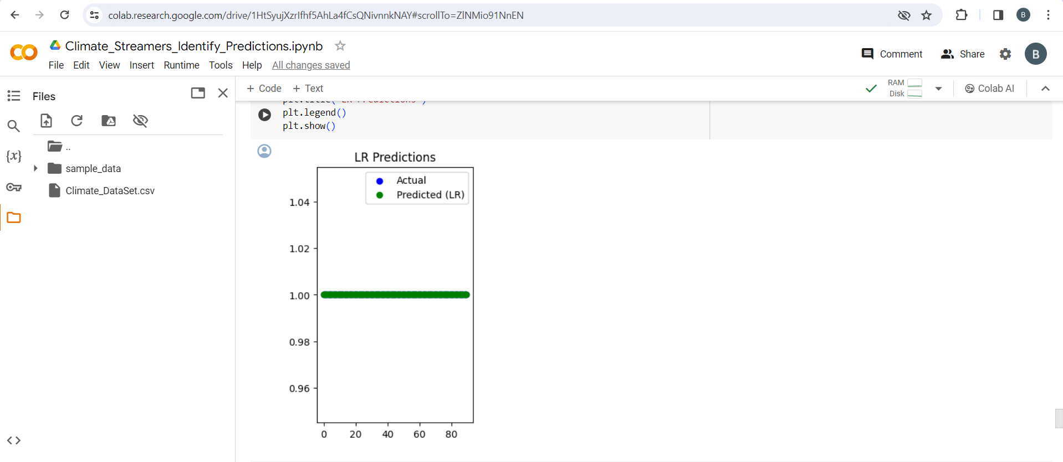
INPUT AND OUPUT

Slide 28
CONCLUSION
Finally predicting the climate data predictions based on the requirements of the client as per the data request by the using the concept of machine Learning algorithm implementations using python finding the climatic conditions streamers data predicting the formats using accuracy. Basically we can forecast the Climatic Conditions based on the Seasonal Requirements. Furthermore, this work identifies current challenges like the limited dataset of chronological seasons and suggests future research directions, including data simulation and the incorporation of physics-based constraints. Thus, the survey not only provides a comprehensive current view but also outlines a roadmap for future interdisciplinary work in this burgeoning field. While the research acknowledges its limitations in providing an exhaustive analysis, it delineates a promising direction for future exploration.

Slide 29
WEB REFERENCES
https://www.mdpi.com/2076-3417/13/21/12019
https://github.com/topics/weather-prediction
https://www.ncdc.noaa.gov/cdo-web/datasets
https://climate.copernicus.eu/climate-datasets

Slide 30
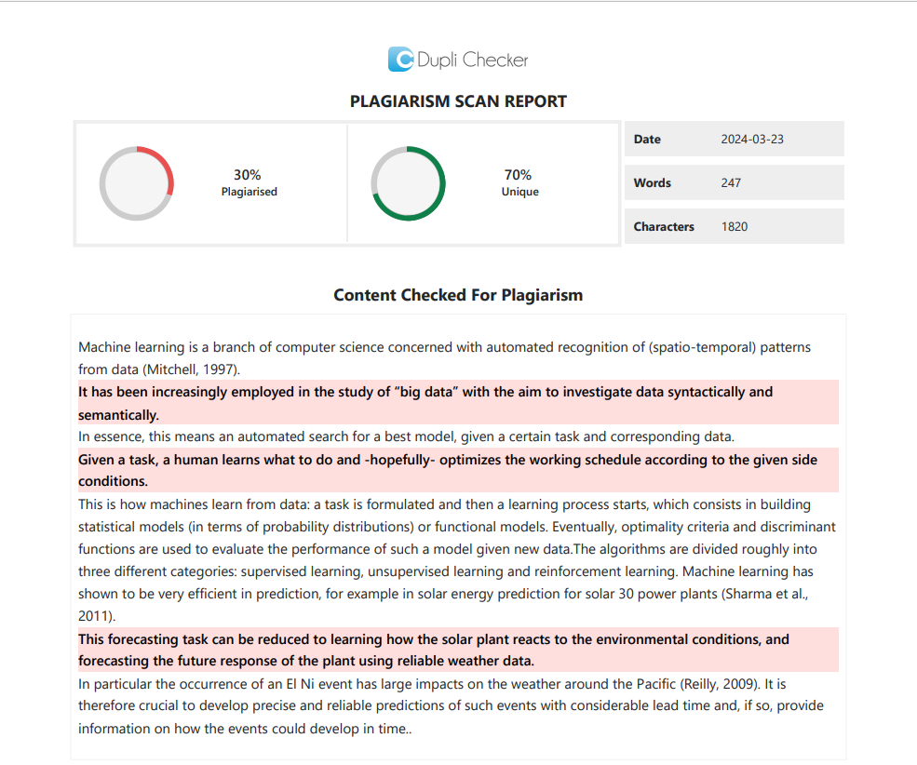
PLAGIARISM REPORT OF PPT

Slide 31
REFERENCES
[1] Olaiya, Folorunsho and Adesesan Barnabas Adeyemo, “Application of data mining techniques in Climate Streamers prediction and climate change studies”, International Journal of Information Engineering and
Electronic Business, Vol. 7.5, No. 6, pp. 51, 2022.
[2] Sawaitul, D. Sanjay, Ramesh Babu, Krishna annaya,K. P. Wagh and P. N. Chatur, “Classification and prediction of future Climate Streamers by using back propagation algorithm-an approach”, International Journal of Emerging Technology and Advanced Engineering, Vol. 2, No. 1, pp. 110-113, 2022.
[3] P. Langley, W. Iba and K. Thompson, “An analysis of Bayesian Classifiers”, in Proceedings of the Tenth National Conference on Machine Learning, San Jose, CA, 2008.
[4] Kotu, Vijay and BalaDeshpande, Predictive analytics and data mining: concepts and practice with rapidminer, Morgan Kaufmann, 2021.

Slide 32
REFERENCES
[5] D. Hand, H. Mannila and P. Smyth, “Principles of data mining”, MIT, 2014.
[6] A. Mccallum and K. Nigam, “A Comparison of Event Models for Naive Random Forest Classifier, Decision tree Classifier work of Classification”, Proceedings of the 15th National Conference on Artificial Intelligence (AAAI-98)-Workshop on Learning for Text Categorization, pp. 41-48, 1998.
[7] R. O. Duda and P. E. Hart, Pattern classification and scene analysis, John Wiley and Sons, 1973.
[8] Mohita Anand Sharma1 and Jai Bhagwan Singh2” COMPARATIVE STUDY OF Climate Streamers predictions models”, Department of Mathematics and Statistics, School of Basic and Applied Science, Shobhit University, Meerut, Uttar Pradesh, 250110, India.

Slide 33
REFERENCES
[9] Razeef Mohd1 , Muheet Ahmed Butt2 and MajidZaman Baba3”Comparative Study of Climate Streamers Prediction Modeling Techniques”, Student, 2 Scientist-D, Department of Computer Science, 3 Scientist-D, Directorate of IT&SS, University of Kashmir, Jammu and Kashmir, India.
[10]Mark Holmstrom, Dylan Liu, Christopher Vo” Machine Learning Applied to Climate Streamers prediction",Stanford University (Dated: December 15, 2022).

Slide 34
THANK YOU

